Slide 1


Bitcoin Price Prediction

Slide 2
1. Introduction
Contents Overview
Design
Implementation
Testing 11.Results 12.Future Work
References
2. problem statement 3.Why this project? 4.What is YFinance? 5.Why we use yfinance? 6.Software model -Agile Process
7.User and System Requirements
2

Slide 3
Introduction
Bitcoin is an innovative payment network and a new kind of money or a cryptocurrency, where cryptocurrency is adigital assetdesigned to work as a exchange medium that usesstrong cryptographyto secure financial
transactions, control the creation of additional units, and verify the transfer of assets. BITCOIN, the first cryptocurrency was introduced in a paper published
in 2008 by an author under pseudonym of SATOSHI NAKAMOTO.
We aim to incorporate machine learning to analyse past fluctuations in
currency prices, and attempt to decipher a trend in prices, this is because we can’t predict accurately and sentiment analysis of bitcoin from twitter tweets.
3

Slide 4
Problem statement
One of the main problems with bitcoin is price volatility, which indicates the need for studying the underlying price model.
This case study o f Bitcoin prices. The paper considered bitcoin data from yahoo finance. It proposed this as both regression and classification problem. For regression the paper was predicting prices & for classification task where an attempt was made to predict increase/decrease in price. It was performed to predict next day, 30th day & 90th day price.
In this case study, we attempt to predict next day prices based on features of previous day using machine learning & deep learning regression algorithms.

Slide 5
Why this project
As we reach, the ending of the course, we will soon be responsible, earning
individuals,
who will want to save money and invest it properly to gain huge benefits.
Since stocks and cryptocurrency trading are in trend, we choose to help common man to learn how this works, and enable them to invest judiciously by studying thisTrend Analysis.
4

Slide 6
what is y finance ?
yfinance is a popular open source library developed by Ran Aroussi as a means to access the financial data available on Yahoo Finance.

Slide 7
why we use y finance?
Yahoo Finance offers an excellent range of market data on stocks, bonds, currencies and cryptocurrencies. It also offers market news, reports and analysis and additionally options and fundamentals data- setting it apart from some of it’s competitors
6

Slide 8
Agile Process Model
2. Planning and Design
1. Requirements Analysis
Each iteration develops the small part of the
s_{p}of_{o}tw_{u}a_{c}r_{t}e. product.
3. Development and
Implementation
4. Testing
9

Slide 9
User And System Requirements
User Requirements
To get the predicted price of a bitcoin
To see the trend in variation of bitcoin
System requirements
To incorporate machine learning algorithms in order decipher the a trend in prices .
To use various API which provides user-friendly UI.
10

Slide 10



ALGORITHM
“
from sklearn.model_selection import train_test_split
from sklearn.ensemble import RandomForestRegressor
from sklearn import metrics
from sklearn.neighbors import KNeighborsRegressor from sklearn import tree
from sklearn.ensemble import RandomForestClassifier from sklearn.ensemble import GradientBoostingRegressor

Slide 11
Step 1:First step is to get the data from the yahoo finance website by using yfinance.
Step 2: we have to import important algorithms which are useful to this project
Step 3: Next, We have to cheak head and tail functions and find null values. and after

Slide 12
Step 4:Filtering the columns which are needed for this project
. Step 5: After completing the eda part divide the data into two parts and train it for machine learning
Step 6: Next, find which is best algorithm and by using R2 score and mse value which gives best accuracy_score choose it and go for test

Slide 13
7
DESIGN
The Model
16

Slide 14
8
Implementation
Model Implementation
19

Slide 15




STEP WISE PROCEDURE
01
Dataset preparation
Import Libraries
Build the Model and feed the data.
Train and validate
02
03
04
20

Slide 16
Data Preparation
Source: https:// yahoofinan ce. com/
Data Preprocessing:
Divide the dataset into and training and testing set.
Normalize and reshape.

Slide 17
Libraries and Tools used
yfinance
Sklearn
NumPy
jupiter-IDE
pandas

Slide 18
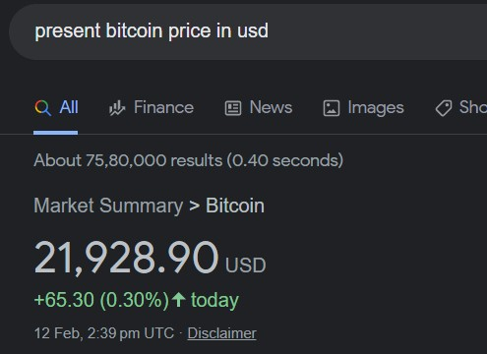
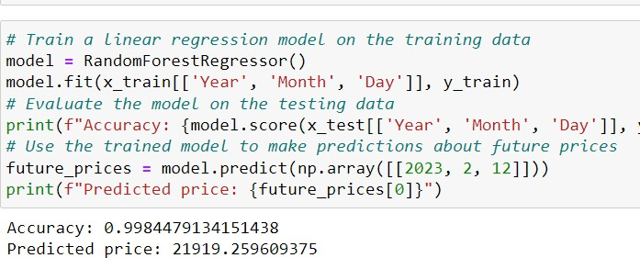
Model.summary()

Slide 19
Access to yfinance data
Request
To yahoo finance API through
yfinance : python client
yahoo finance developer
application
jupiter : used to process textual data, remove hashtags, focuses on adjectives/adverbs, removes stopwords, used to apply sentiment analysis.
Visualization of the implementation

Slide 20
9
Testing
Last step in the process of Development
31

Slide 21
11
Future Scope
Future Aspects and Incremental Work possible

Slide 22
1.Use to predict the prices of other cryptocurrencieslike litecoin, ether etc., 2.We tried to incorporate the idea of transfer learning, this model can be optimized for better performance.
3.The web application which is the final software product of this project can provide numerous other applications on single site like -live sentiment
analysis of bitcoin, tutorial to do trading using bitcoincrypto currency etc., 4.The result predict from the model and the idea of sentiment analysis can
be combined to predict the prices more accurately, this predictedprice will
use both -historical data and current events related to Bitcoin.

Slide 23
THANK YOU
40

